Slide 1
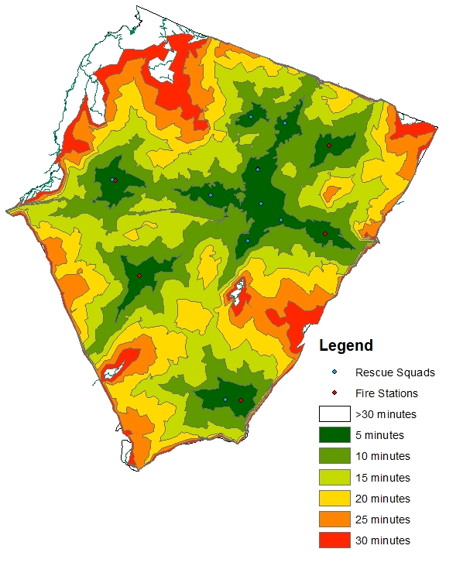
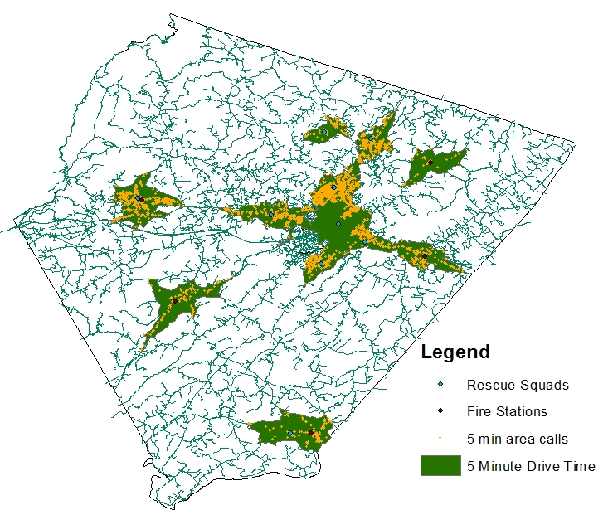
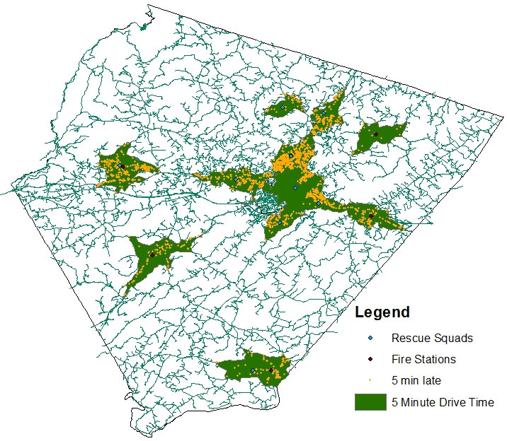
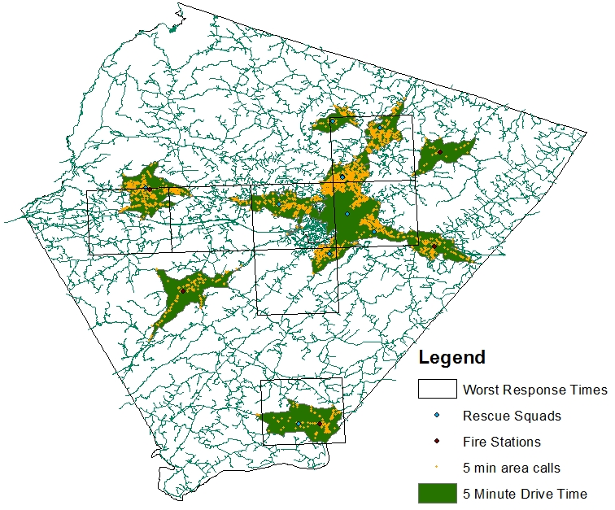
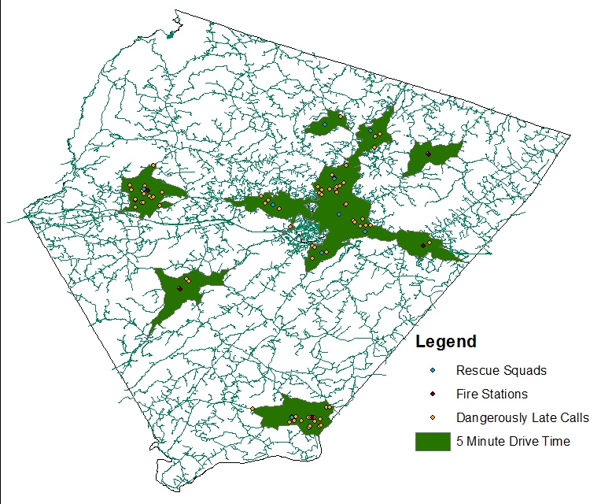
Essential Questions 1. How efficient are Albemarle EMS/Fire Responses based on drive time vs. response time? 2. Which areas experience the most efficient responses? 3. Which areas experience the worst response times? Possible reasons for both?
Efficiency of Albemarle County EMS Response Times
Response Time Rings
All Responses 2015
Greater than “5 Minutes”
All Responses Within 5 Minute Ring
Responses within the 5 minute drive time that took longer than 5 minutes (anywhere from 6 minutes to 25+ minutes). 9,630 out of 18,523 responses were reached in more than 5 minutes, an efficiency rate of about 48% of calls being reached on time.
Raw expected drive times for Albemarle County.
Every response that should’ve taken 5
minutes or less to respond to in raw drive time.
Every Fire/Rescue response for
the 2015 calendar year.
Worst Response Times
>20 Minute Response Time
Analysis Steps
* Obtained raw data from the county GIS with latitude/longitude.
* Plotted points using the Nad_27 projected coordinate system.
* Ran a drive time analysis using network analyst.
* Isolated the points within the 5 minute drive time in order to run further analysis.
* Used a fishnet layer, we created a spatial join to identify areas
where the majority of late responses were taking place.
These are the areas that experience the worst response times within the 5 minute drive time. These areas are heavily populated and the longer response times are due to increased traffic and construction.
116 responses out of 18,523 responses within the 5 minute drive time were classified as “dangerously late.” This is 0.01% of responses.
Chris & Matt - AHS

