Slide 1
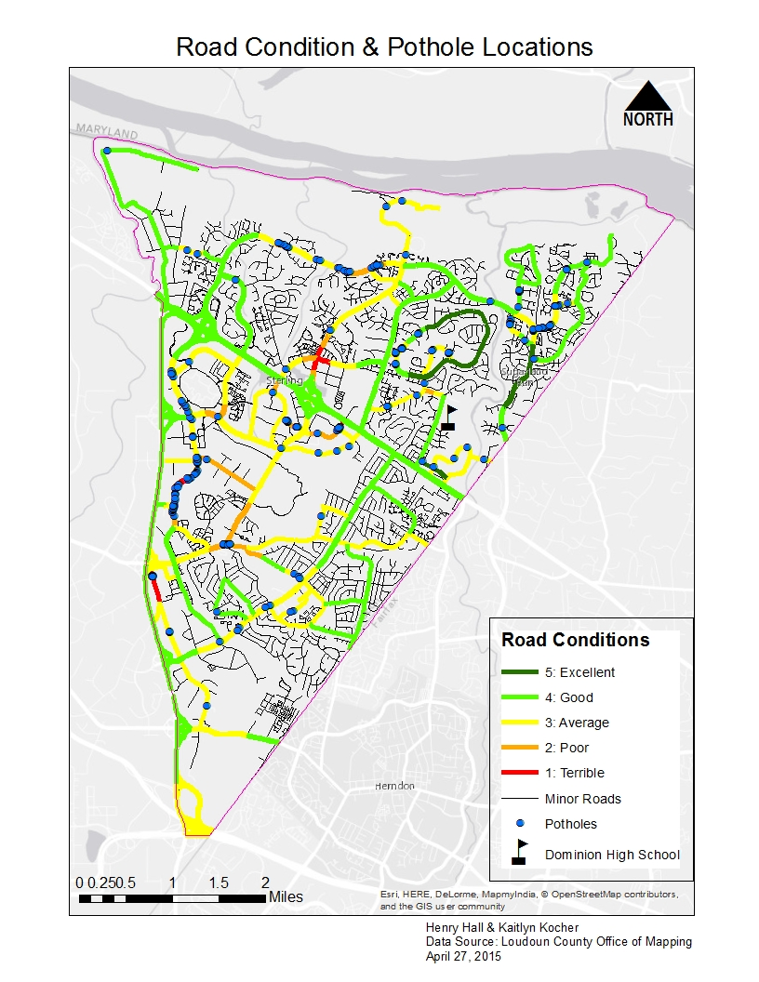
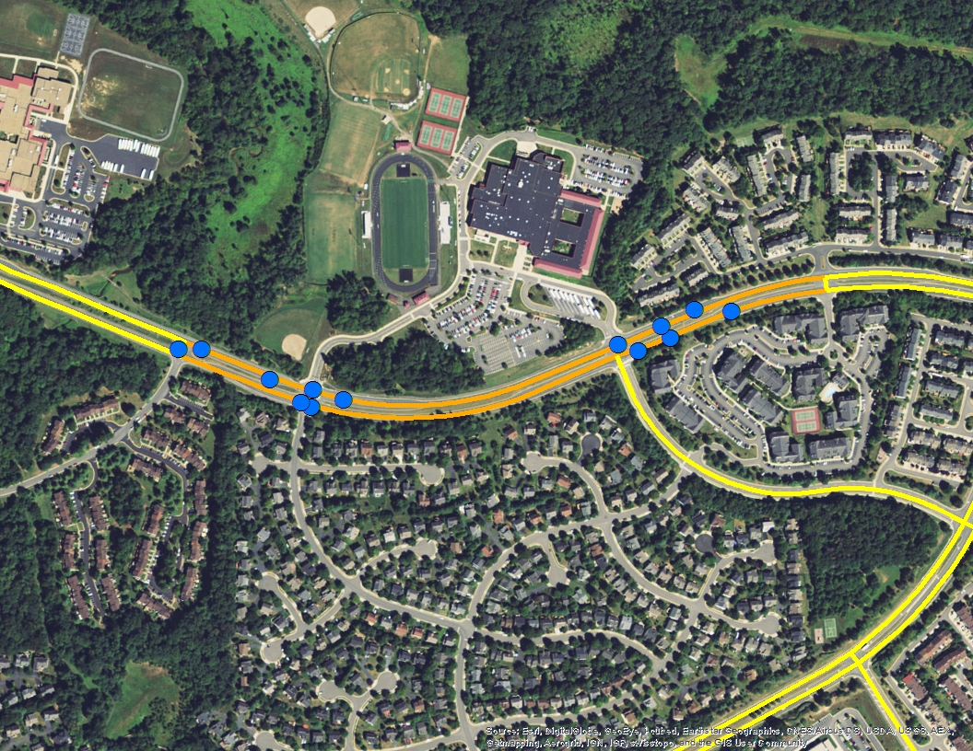
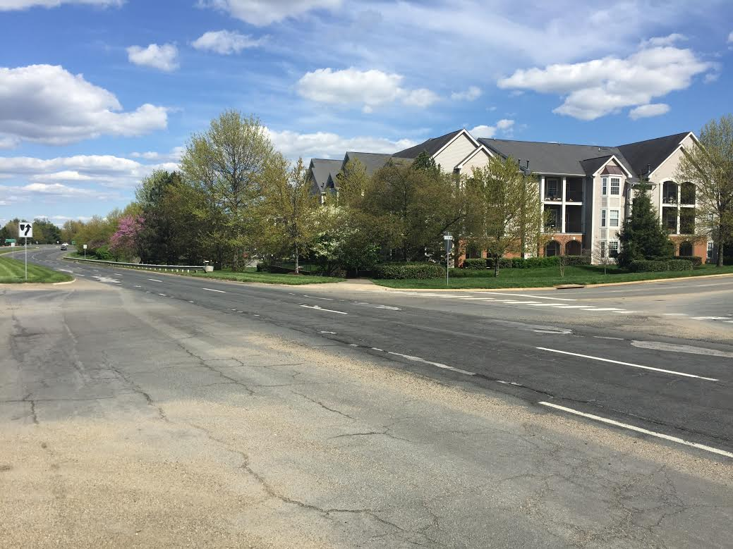
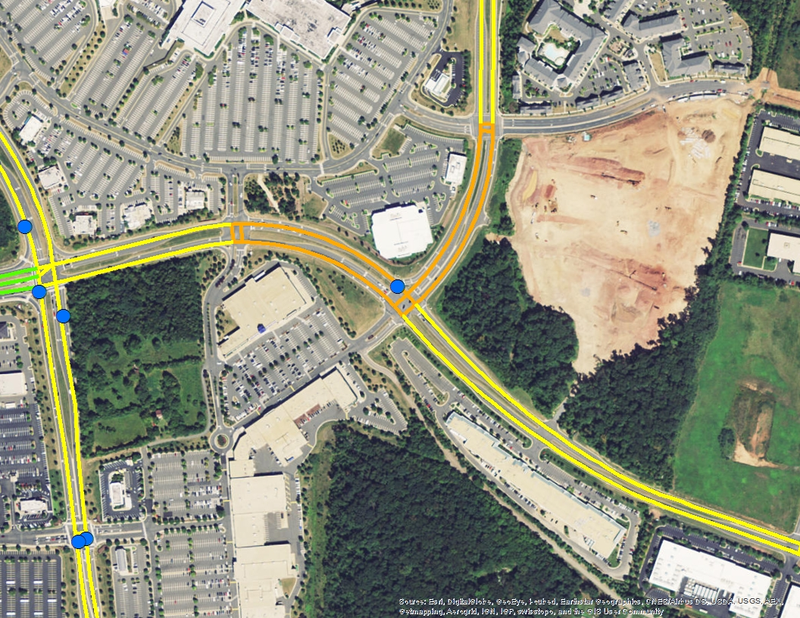
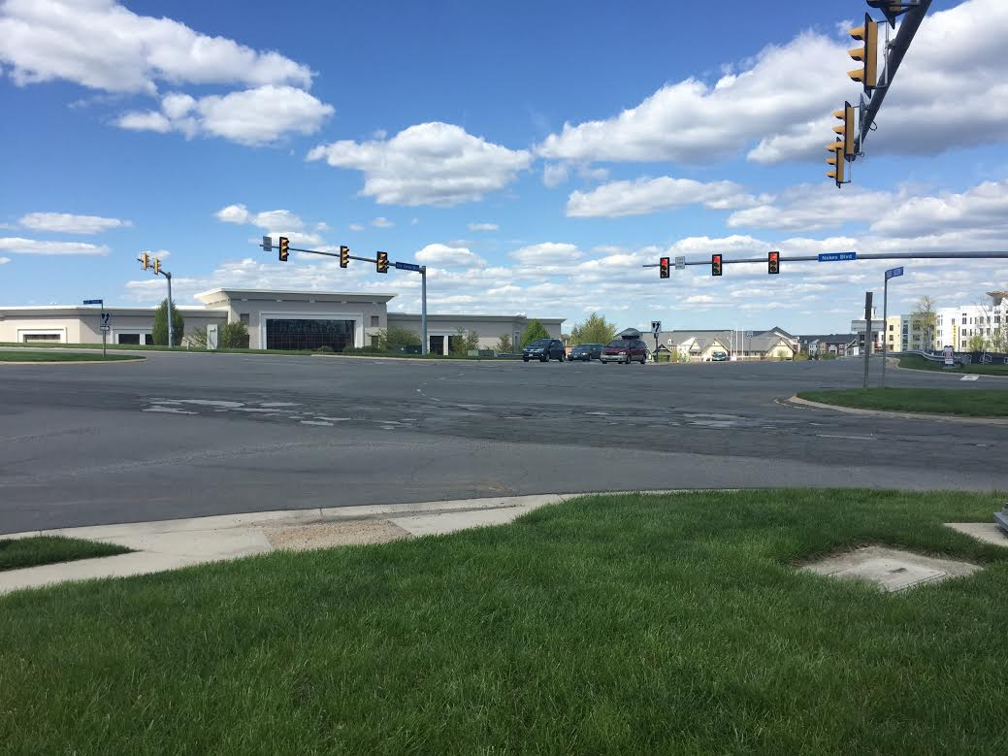
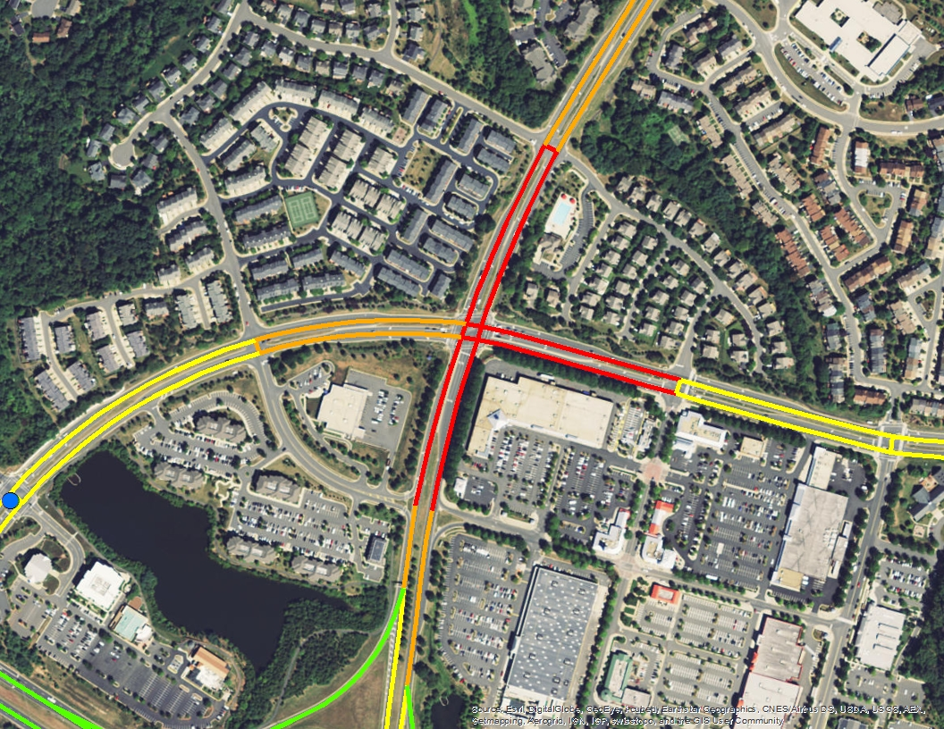
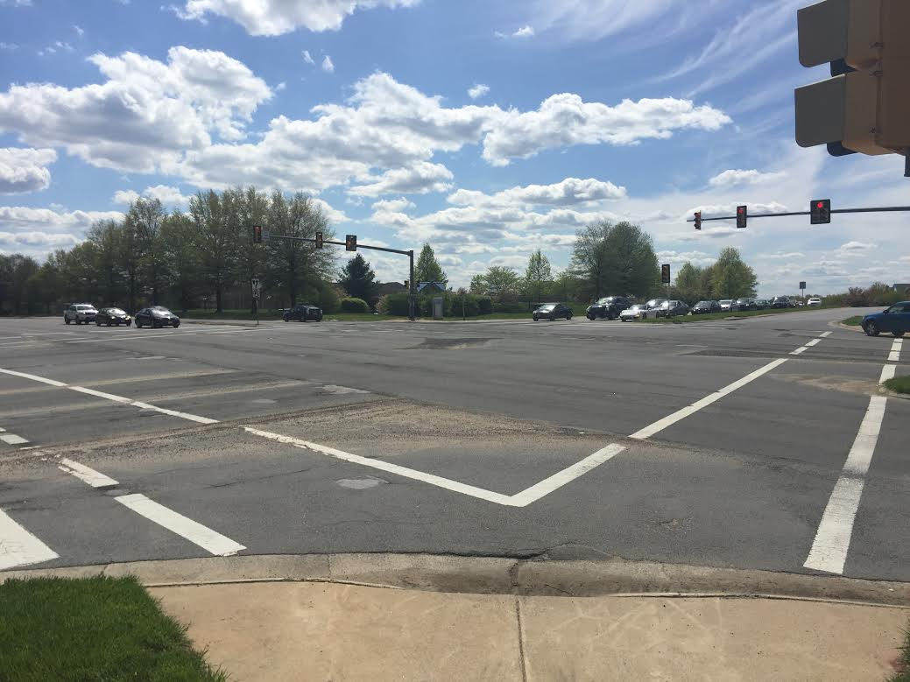
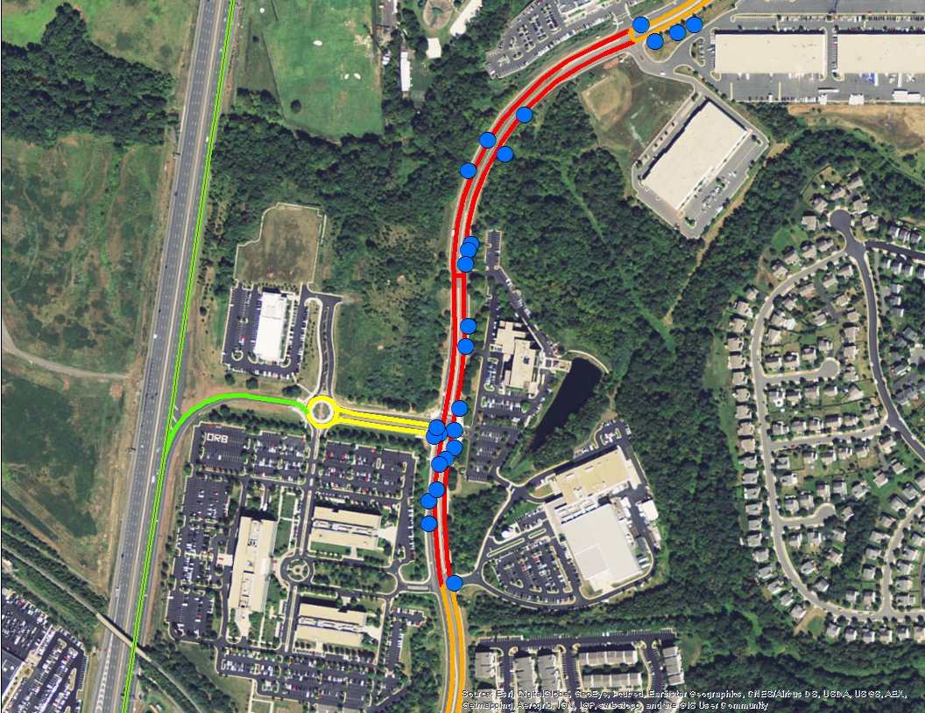
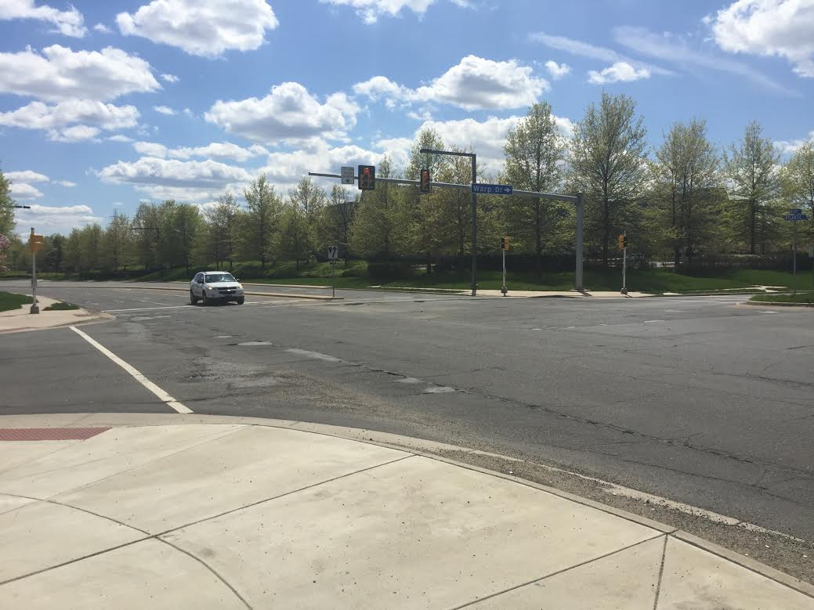
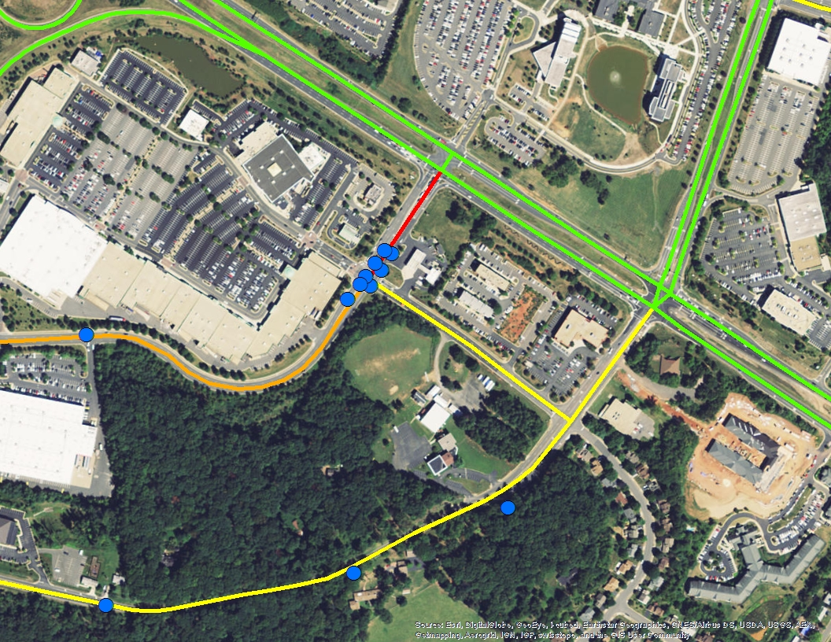
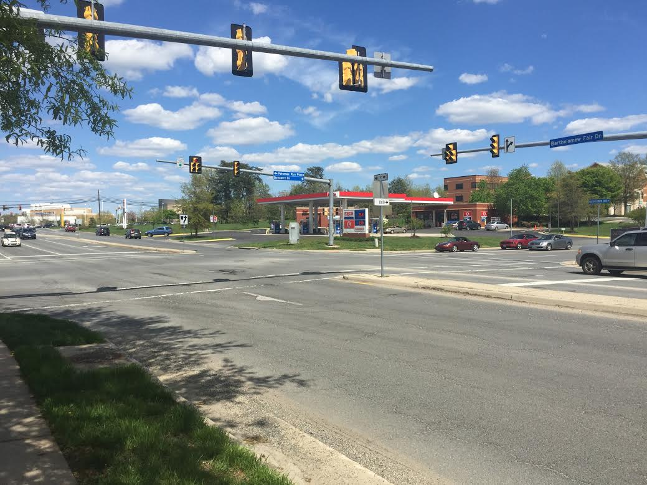
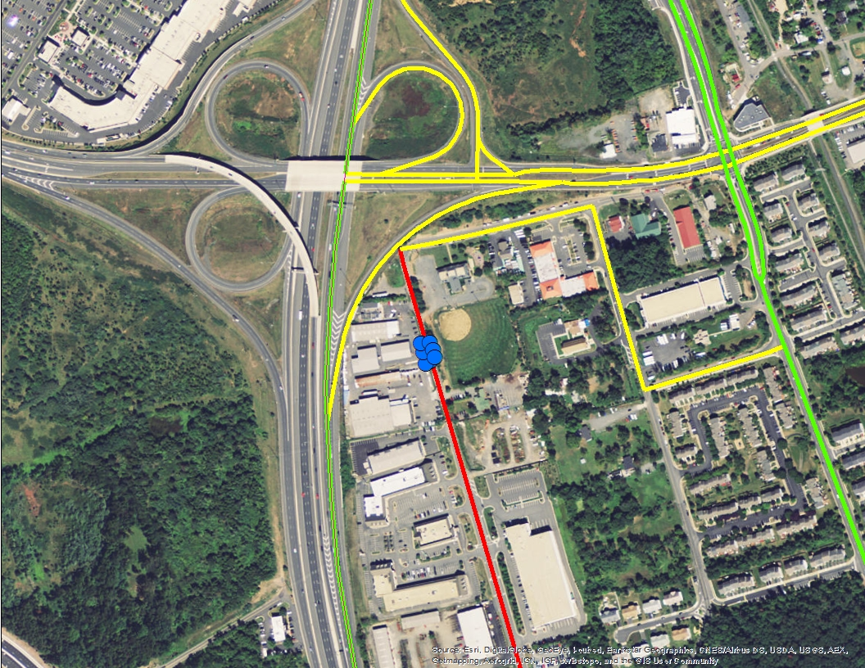
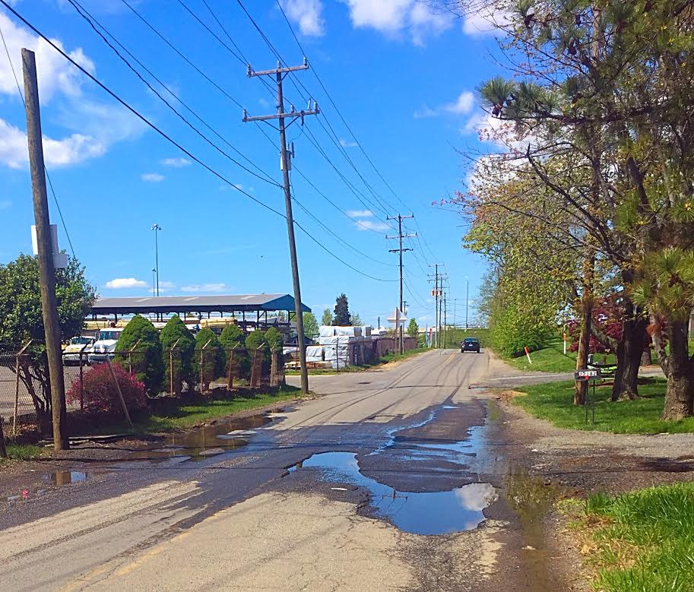
Potholes & Condition of Major Roads in Sterling, VA
Key Locations
#1 – Algonkian Pkwy / Middlefield Dr
#4 – Nokes Blvd / City Center Blvd
1
4
1
At this location Algonkian Pkwy was given a rating of 2. This was as a result of 18 potholes measured within a 0.6 mile stretch of road, in the vicinity of Middlefield Dr. These potholes have been paved over; however, road condition is still poor as a result of the numerous potholes which have been filled.
This intersection is similar to site #2 as while there are few actual potholes in the intersection, the road condition is rather poor due to previously paved over potholes. Most of the vicinity around the intersection was given a rating of 2, while others were given a 3. The crossroads had one moderately sized pothole, which hasn’t been filled.
2
3
#2 – Cascades Pkwy / Palisades Pkwy
#5 – Atlantic Blvd / Warp Dr
4
5
2
5
6
This busy intersection has deteriorated greatly over the past winter. Motorists must slow down when they pass through the intersection as a result of the dips and loose gravel in the intersection. The majority of the intersection was given a 1, even though there were no actual potholes in the intersection.
This half-mile stretch of Atlantic Boulevard is a moderately-traveled four-lane road. At the time when this stretch of road was first examined 25 potholes were found. Since that time the potholes on this stretch have been filled. Nonetheless, road condition is still quite terrible as a result of the former potholes.
#3 – Bartholomew Fair Dr / Benedict Dr
#6 – Shaw Rd / Old Church Rd
3
6
The purpose of this project was to provide the Virginia Department of Transportation with data about pothole locations and dimensions enabling them to prioritize road repairs. This year road conditions were especially poor after a rough winter. Data was collected by driving major roads and manually recording the locations, pothole depth and width, and overall road conditions. A Likert Scale was used to define the quality of the roads. Six key locations were identified, listed in no particular order to the right, for areas that VDOT should focus their efforts on.
The road segments around this intersection range from terrible to average. The 9 potholes , one of which is nearly 6 in. deep and 15 in. Wide, in the range of the intersection are yet to be filled. They are gradually worsening in condition, and motorists bounce in their cars when passing over the largest of the potholes in the intersection.
This location is by far the least traveled key location that was chosen. But its potholes are the worst in Sterling. A total of 7 potholes occupy this location south of Old Church Rd. The potholes are yet to be filled, and are commonly home to large puddles which forces drivers to slow down and swerve around.
Henry Hall 703-444-3344 kallo@comcast.com
Kaitlyn Kocher 703-430-8628 kaitlynkocher4@gmail.com

